Slide 1
HR Attrition CASE STUDY
SUBMISSION
Group Name:
Abhishek Bansal
Puneet Tripathi
Melvin Vallully
Srishti Khanna

Slide 2
Abstract
XYZ, employs around 4000 employees
Their yearly attrition is around 15%, resulting in
Delayed Projects
Need for more backup resources
More number of trainings and onboarding sessions for New employees
All the above factors is impacting their operational cost and brand value

Slide 3
Problem solving methodology
Use flow chart

Slide 4
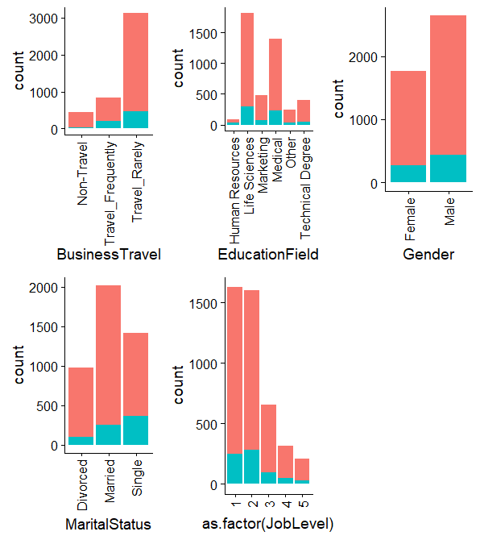
Variables across attrition
BusinessTravel has a clear impact on attrition
Other variables too are showing significant spread for attrition
Numberwise More Males leave job but percentagewise women leave more
Singles tend to quit jobs more than married and divorced

Slide 5
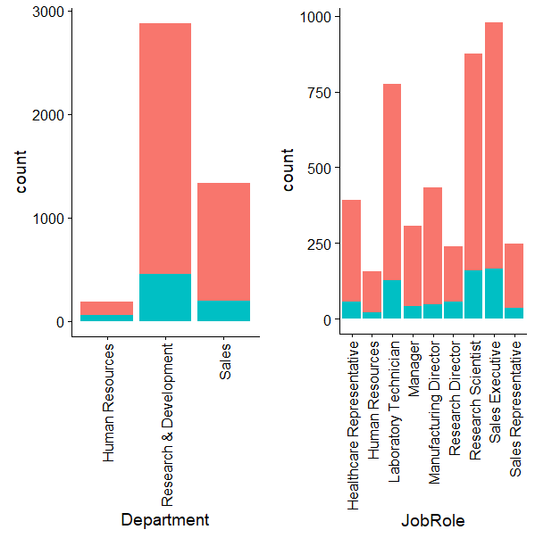
Variables across attrition
People working in Research be it Research Scientist or Lab Technician quits job more than others
Sales executives are also attrition prone more than others

Slide 6
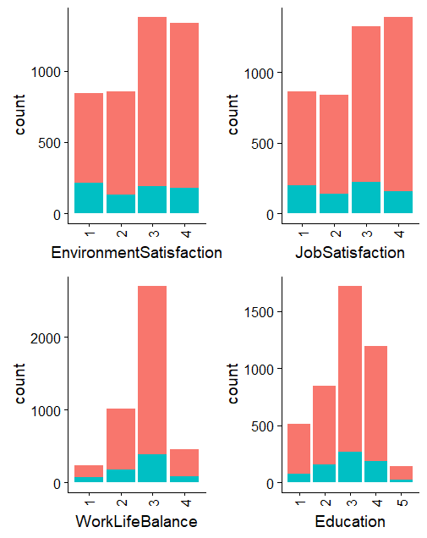
Factor (ordinal though) but have numerical value
WorkLifeBalance & Eduation is an important Factor
Looks like EnvironmentSatisfaction and JobSatisfaction explains variance in similar fashion

Slide 7
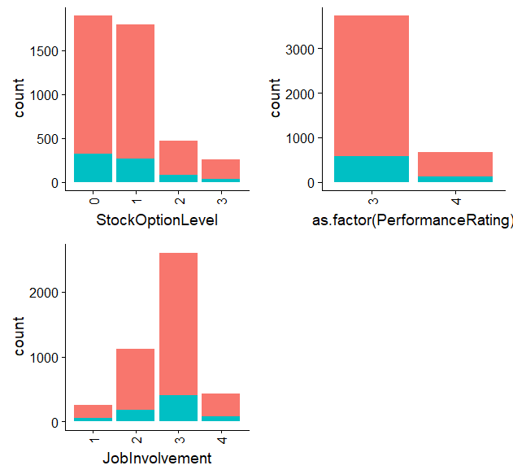
Variables are not continuous but categorical (ordinal) in nature
All of these variables looks important as they have significant attrition spread
StockOptionLevel and JobInvolvement looks like key

Slide 8
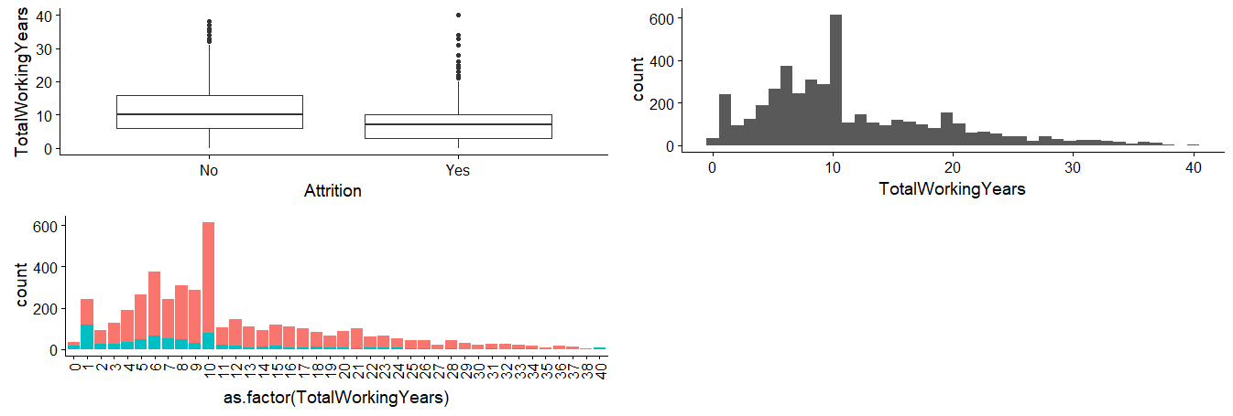
Total Work Experience
People leaving company have median 7 years of experience and have relatively lower overall experience
This might mean as people get more experienced they tend to stay at same company for longer time

Slide 9
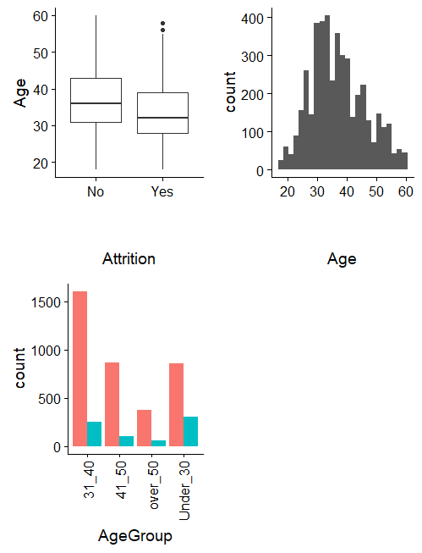
Age
Mostly work force has age between 25 to 50
People resigning appears to be relatively younger ones
We will use AgeGourp for modeling as it gives a creaer picture, So dropping Age

Slide 10
<Results>

Slide 11
<Results>

Slide 12
<Conclusions>

